Slide 1
Calatrava and Symmetry
Symmetry and Calatrava
I.S.I.S Edith Stein
Gavirate - Italy

Slide 2
Who is Calatrava?

Slide 3
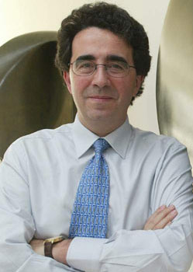
Biography
Santiago Calatrava Valls , born on 28th July 1951 in Benimàmet (Valencia), is a Spanish architect, sculptor and structural engineer.
Classed now among the elite designers of the world, he has offices in Zürich, Paris, Valencia, and New York City.
In the projects, he continues a tradition of Spanish modernist engineering that includes Félix Candela and Antonio Gaudí.

Slide 4
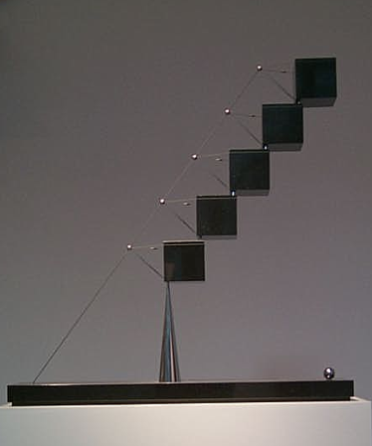
Calatrava's early career was largely dedicated to bridges and train stations, whose designs elevated the status of civil engineering projects to new heights.
Calatrava is also a prolific sculptor and painter, claiming that the practice of architecture combines all the arts into one.

Slide 5
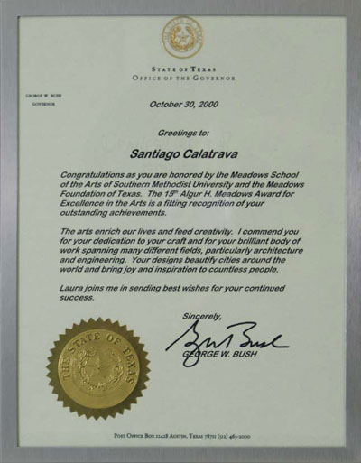
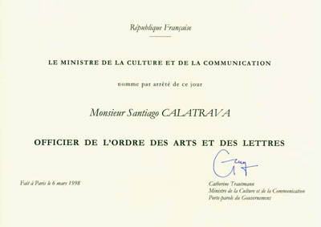
Calatrava has received many acknowledgements. He received the Médaille d'Argent de la Recherche et de la Technique in Paris, the Gold Medal from the Institution of Structural Engineers, the Gold Medal from the American Institute of Architects.

Slide 6
Why Calatrava?

Slide 7
Calatrava and Mathematics
For Santiago Calatrava scientific analysis, computation and mathematical modeling insolvably interweave with the artistic and expressive research.
It is apparent that his work arouses interest and curiosity among all the scholars who explore the links between mathematics and art.

Slide 8
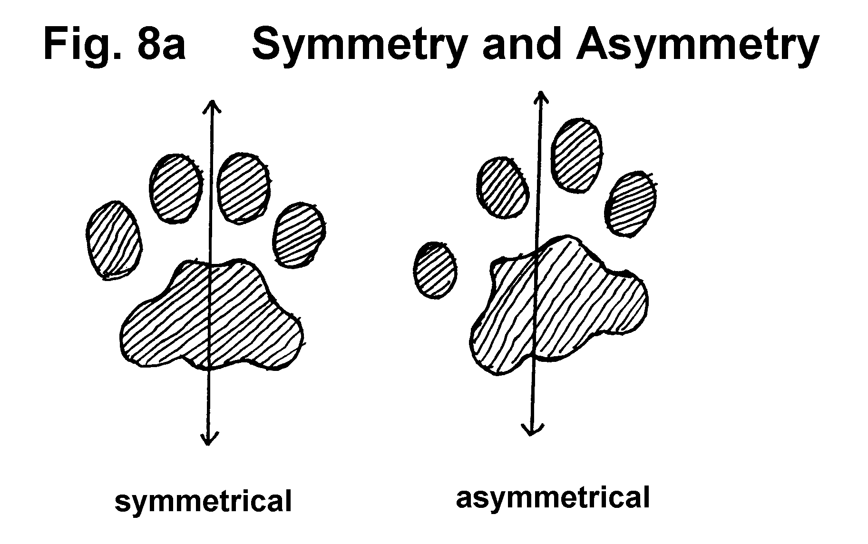
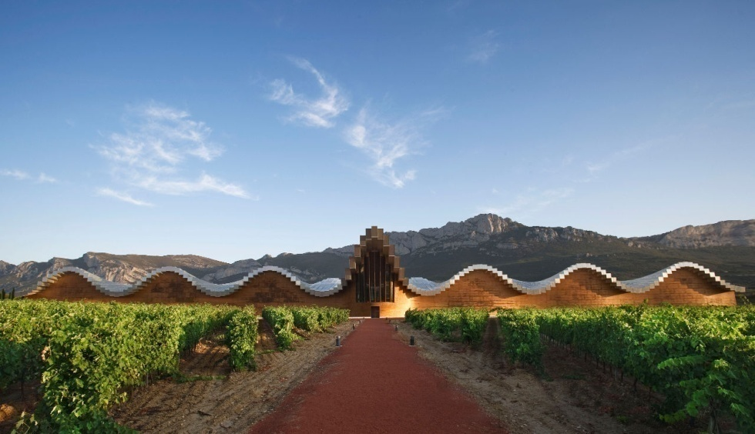
Symmetry
The theme of our “Comenius Project” is symmetry.
Symmetry is when one shape becomes exactly like another if you flip, slide or turn it.
We decided to link it with architecture and Calatrava’s work is one of the best examples.

Slide 9
He studies the symmetry in nature and human body, that often inspire his works...

Slide 10
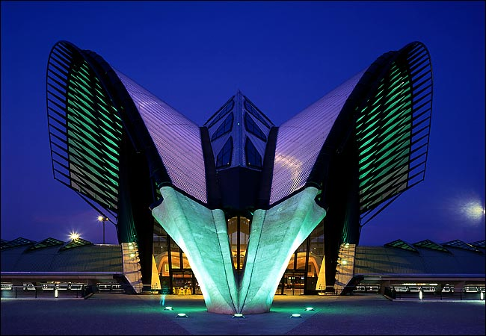
Lyon train station

Slide 11
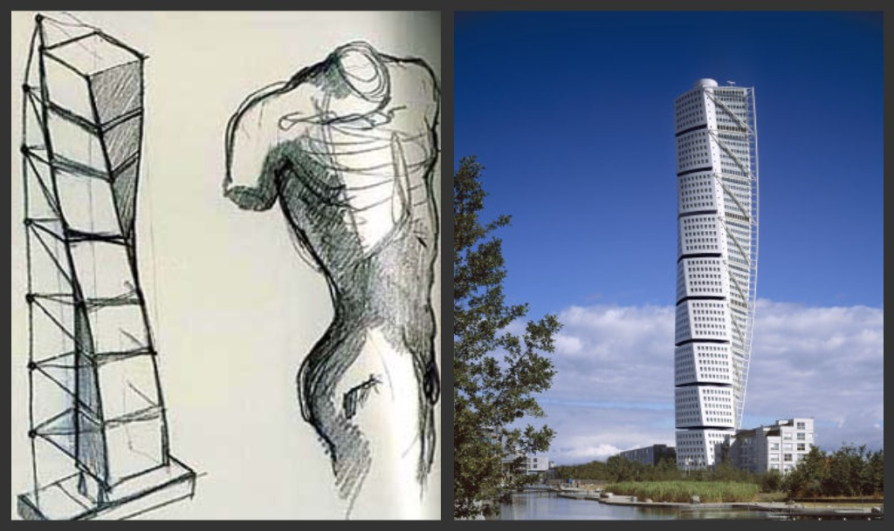
The Turning Torso is the tallest skyscraper in Sweden and the Nordic countries, situated in Malmö, Sweden. It was the tallest building in Scandinavia, the tallest residential building in the EU and the second tallest residential building in Europe.

Slide 12
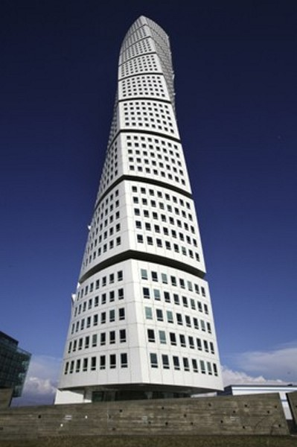
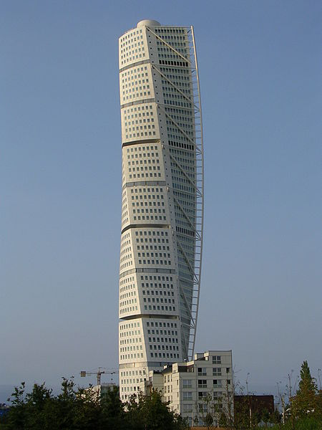

Slide 13
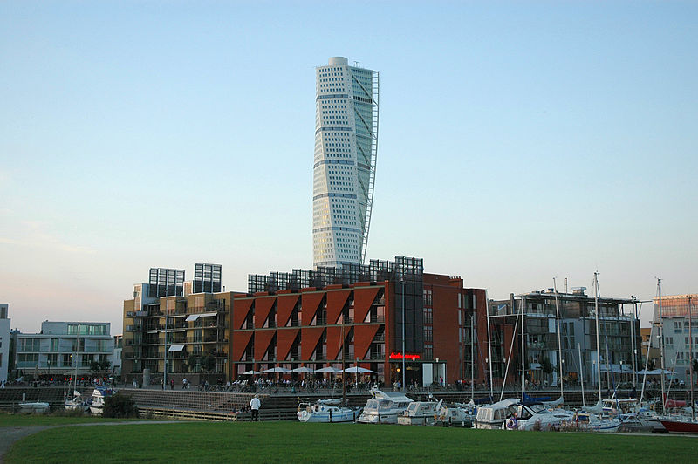

Slide 14
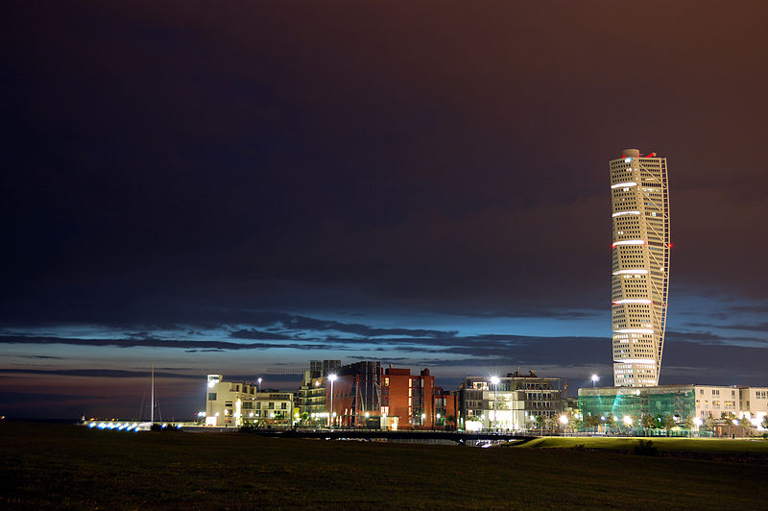

Slide 15
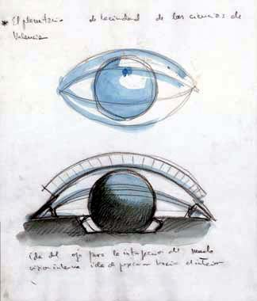
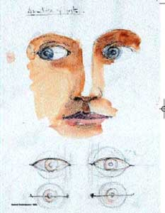
His paintings…

Slide 16
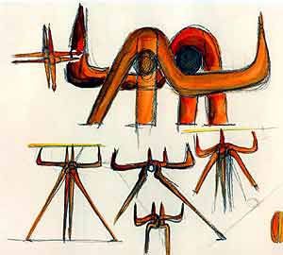
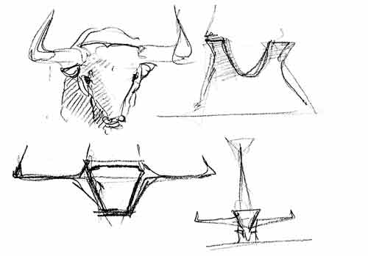
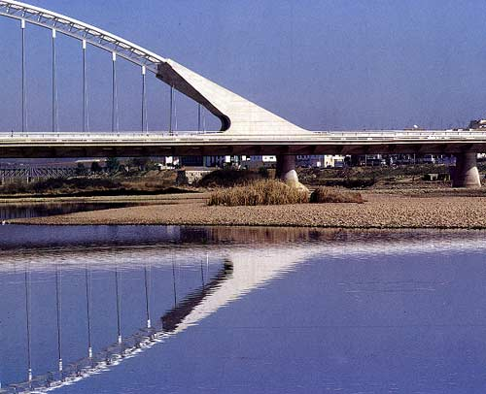
Bull's horns serving as a source of inspiration for legs on an occasional table (1994)
Bull’s head also inspires the shape of the Lusitania Bridge

Slide 17
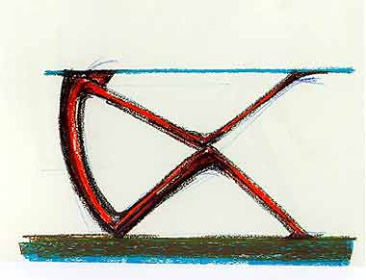
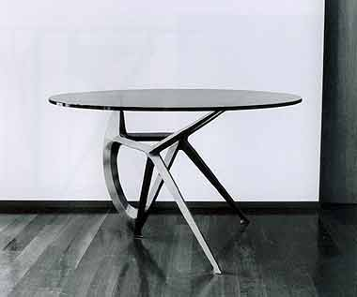
Drawing for anthropomorphic table with glass top (1998)
Anthropomorphic table, metal and glass

Slide 18
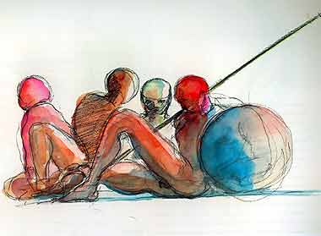
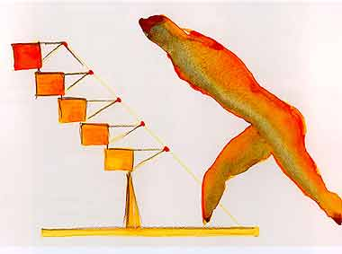
Watercolor drawing inspired by Classical pediment sculpture (1997)
Running torso and cube sculpture (Drawing 1995)

Slide 19
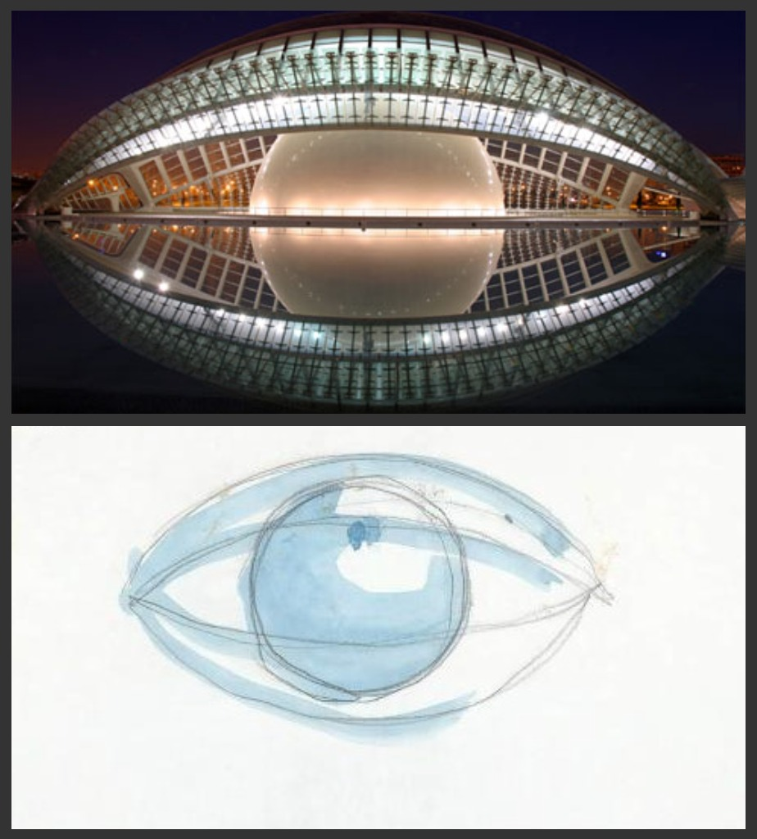
The Hemisfèric is an Imax Cinema, Planetarium and Laserium.
The building is meant to resemble a giant eye, and has an approximate surface of 13,000 m². It’s part of the City of Arts and Sciences in Valencia.

Slide 20
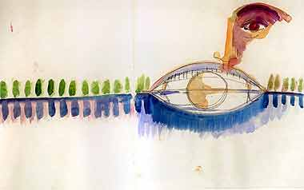
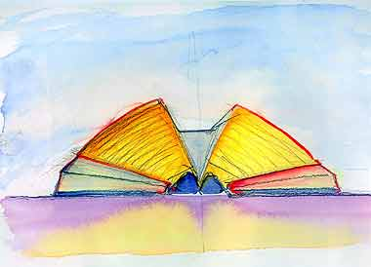
Drawings for L'Hemisfèric (Planetarium), Valencia, Spain

Slide 21
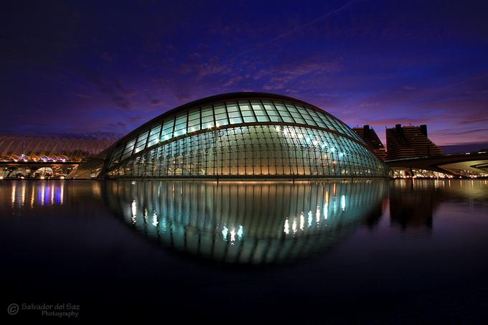

Slide 22
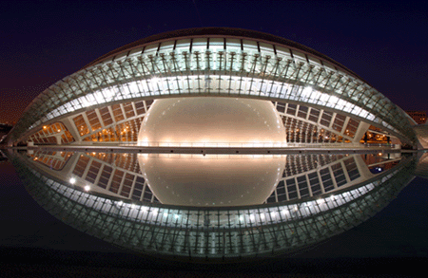

Slide 23
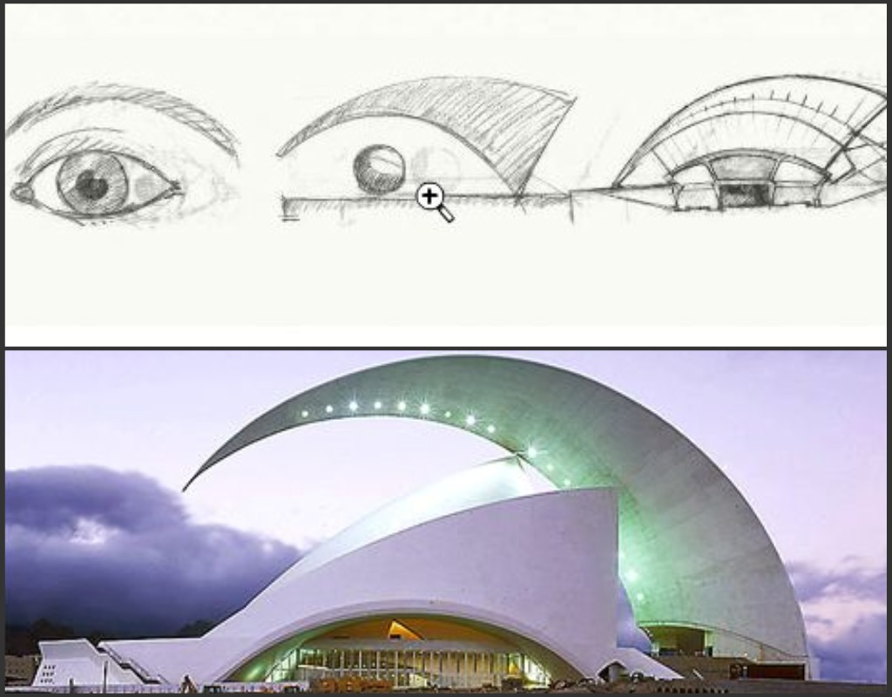
The Tenerife’s Auditorium has become an architectural symbol of the city of Santa Cruz de Tenerife, the island of Tenerife and the Canary Islands.
It is also regarded as the finest modern building in the Canary Islands and one of the most emblematic buildings of Spanish architecture.
It is one of the major attractions of Tenerife.

Slide 24
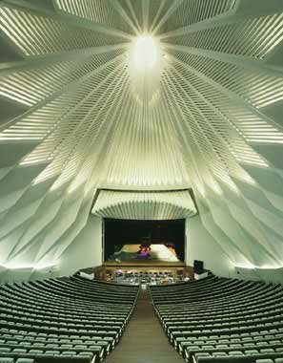
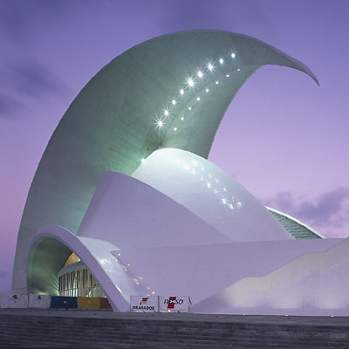
Inside
Outside

Slide 25
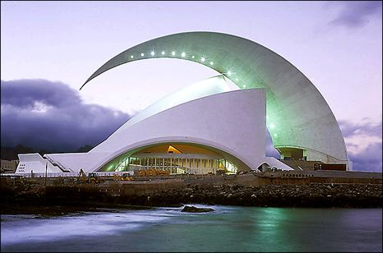

Slide 26
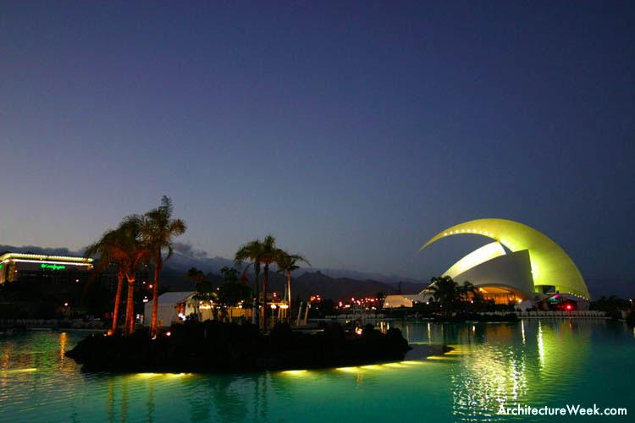

Slide 27
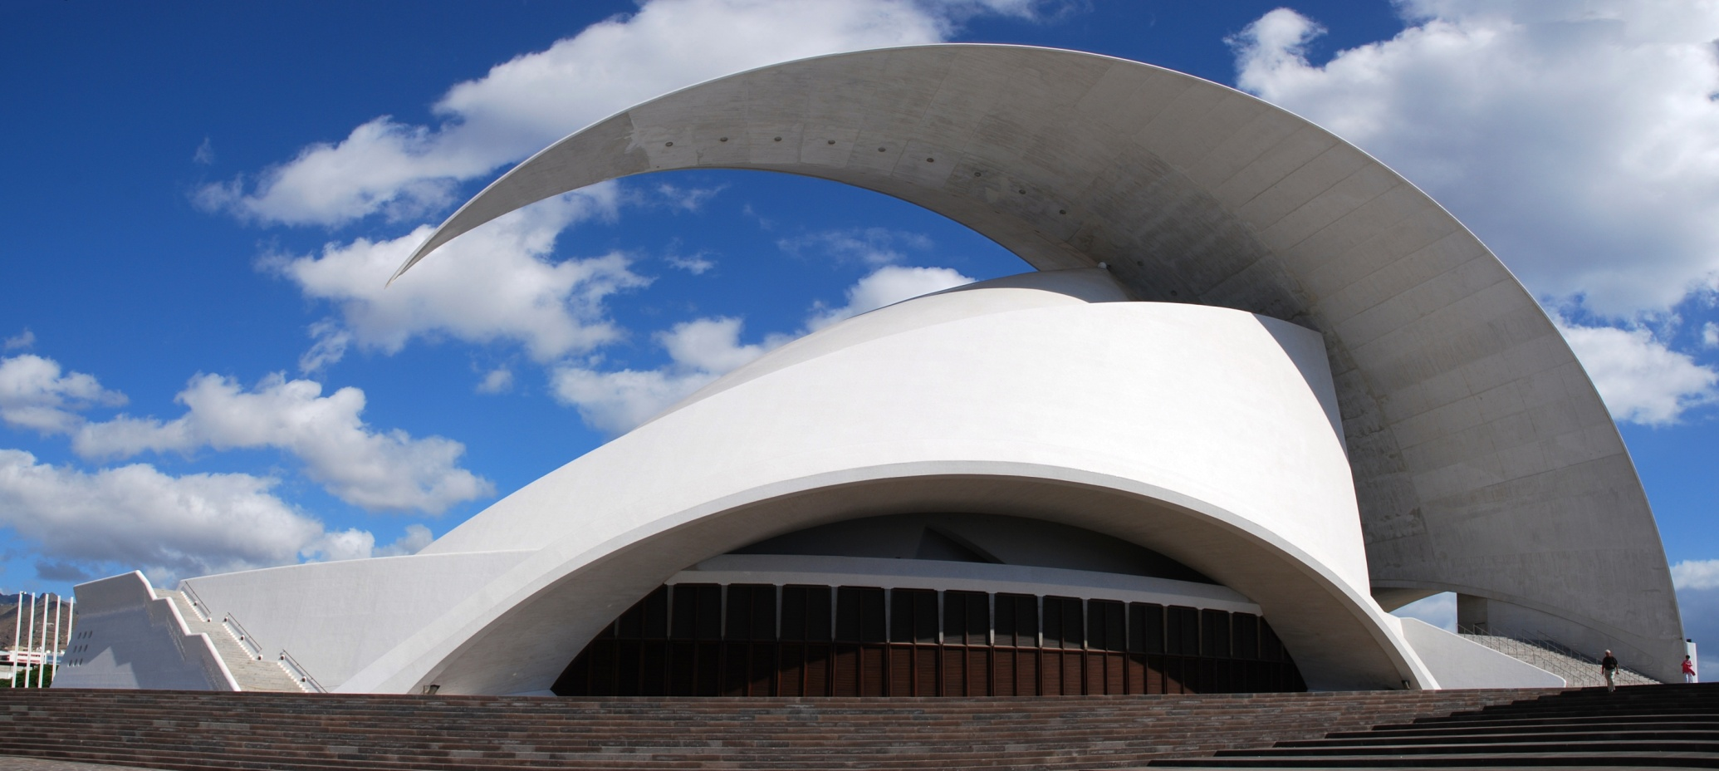

Slide 28
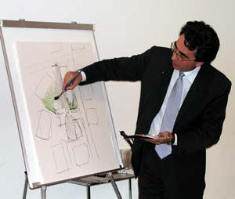
in the

Slide 29
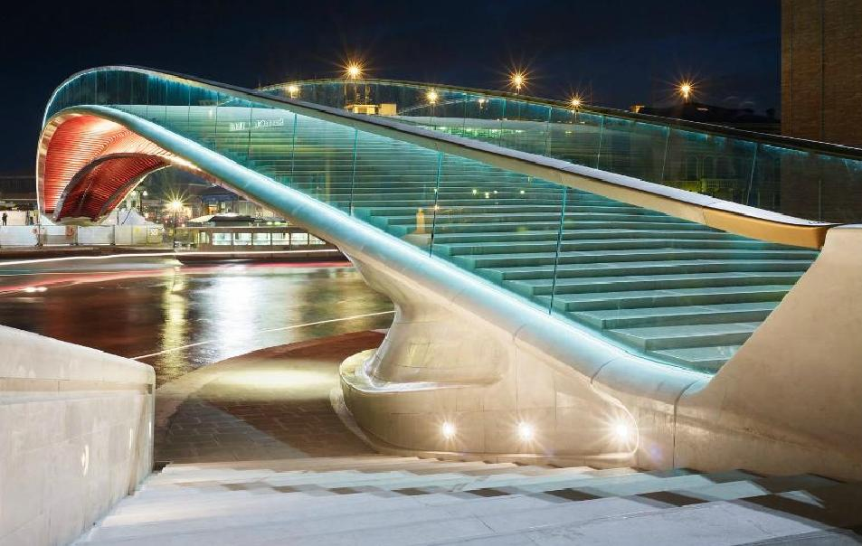
The Constitution Bridge in Venice is defined by Calatrava himself as a walkway of light. The structure linking Piazzale Roma with Santa Lucia railway station offers Venice a prominent contemporary landmark and is a strategic part of its integrated transportation system.

Slide 30
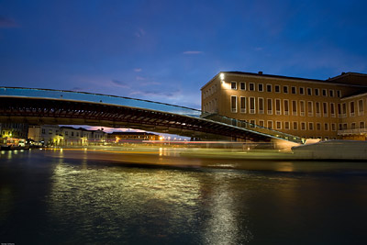

Slide 31
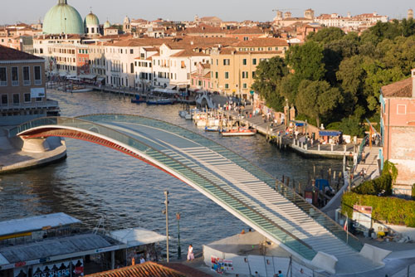

Slide 32
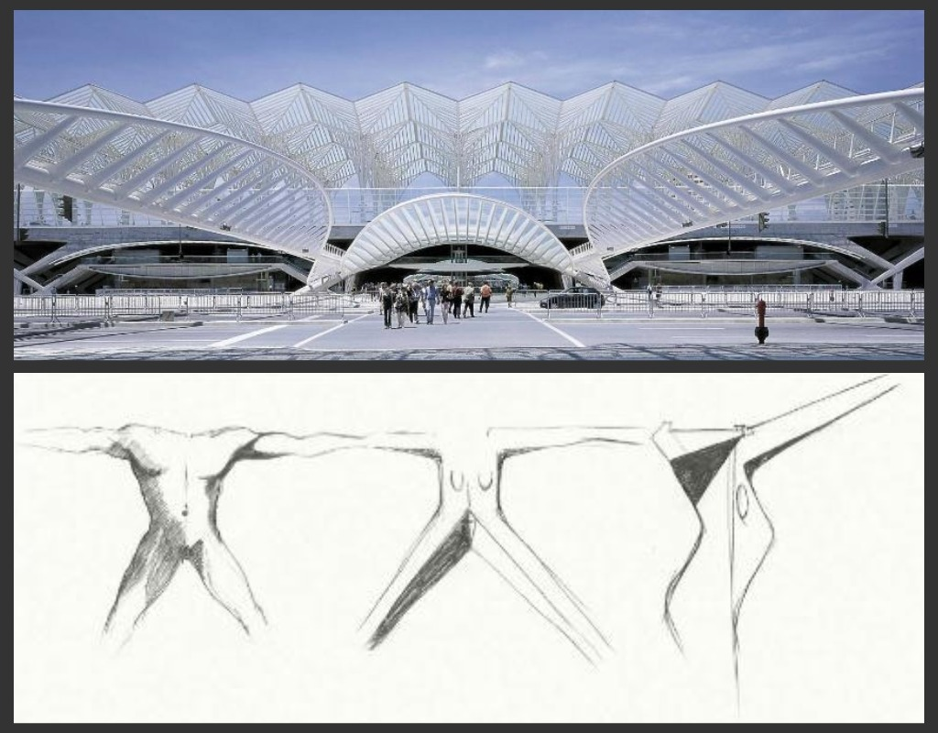
One of the most stunning modern sights in Lisbon is Oriente Station.
The station will soon be expanded to become the main terminal of the high speed train service planned for Lisbon.
Oriente Station is one of the world's largest stations, with 75 million passengers per year which makes it as busy as Grand Central Terminal in New York.

Slide 33
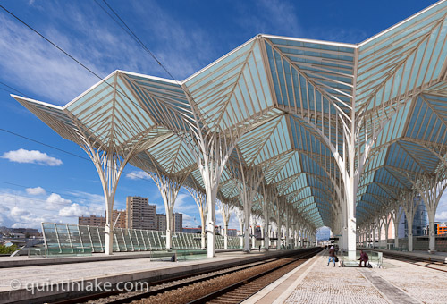

Slide 34
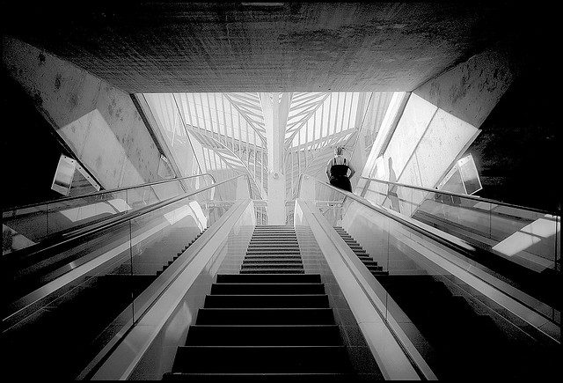

Slide 35
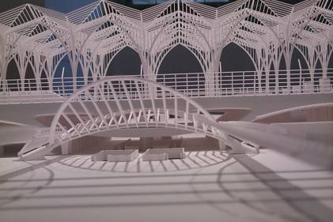

Slide 36
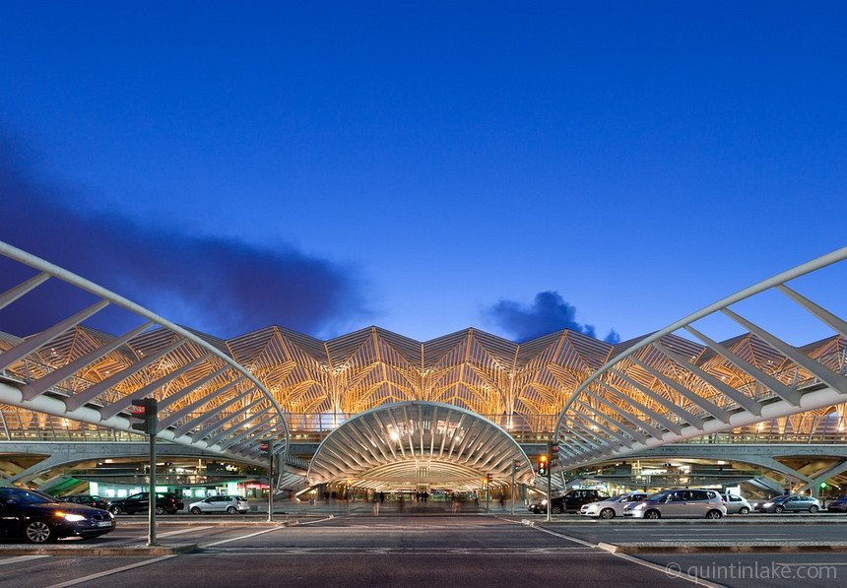

Slide 37
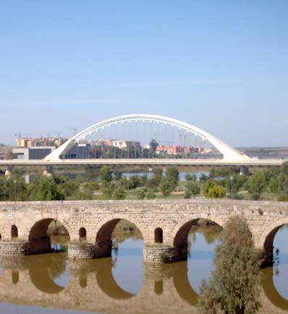
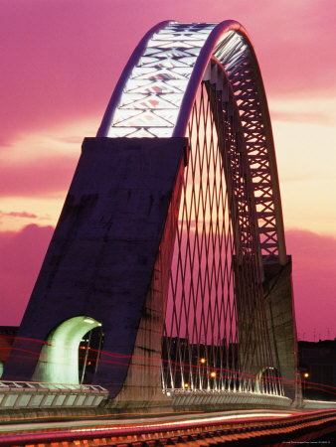
Lusitania Bridge
The Lusitania Bridge was designed to supplement a 2000 year old Roman bridge, the La Akazaba.

Slide 38
Milwakee Art Museum
The footbridge
A suspended pedestrian bridge with a 200-feet-tall angled mast and cables crosses Lincoln Memorial Drive at O'Donnell Park.

Slide 39
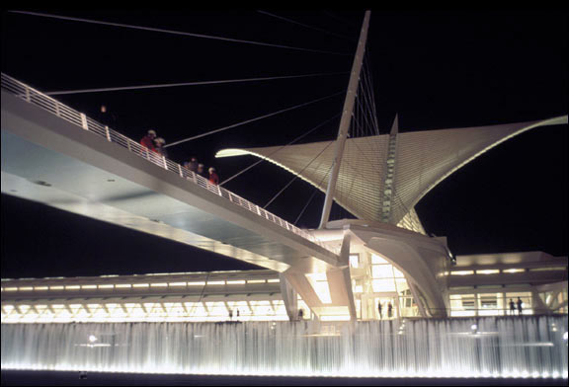
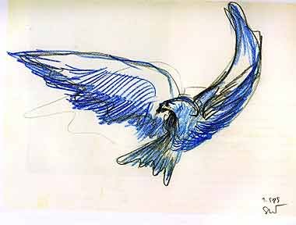

Slide 40
PATH Transportation Hub (NY)

Slide 41
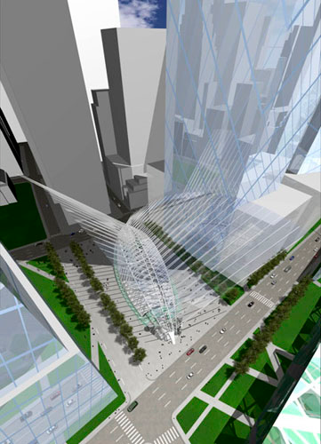

Slide 42
City of Arts and Science (Valencia)
“As the site is close to the sea, and Valencia is so dry, I decided to make water a major element for the whole site using it as a mirror for the architecture.” (Santiago Calatrava)

Slide 43
The City of Arts and Sciences is a large-scale urban recreation center for culture and science which also incorporates L’Oceanogràfic, an underwater city designed by the late Felix Candela.

Slide 44
Athens Olympic Sports Complex

Slide 45
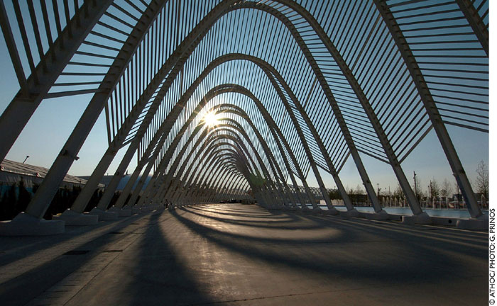
Santiago Calatrava was commissioned to design several of the venues for the 2004 Summer Olympics in Athens, Greece

Slide 46
Allen Lambert Galleria (Toronto)

Slide 47
Walking through this gallery, we are with Calatrava inside the belly of a dynosaur: the rib cage is going to expand in a powerful breathe, the limbs must move, the big jaws open and close. Nature and technology are mixed with present and past.
[A. Saggio]

Slide 48
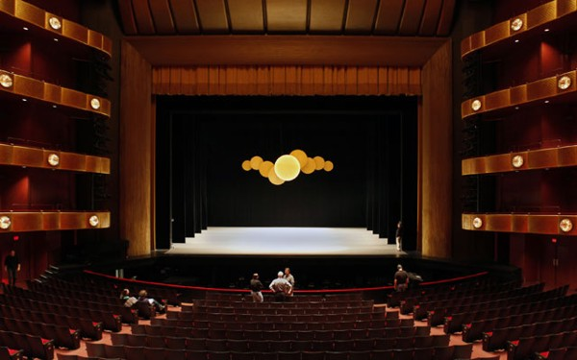
Calatrava: Architecture of Dance
Calatrava designed five stage sets for the New York City Ballet’s new season entitled Architecture of Dance, celebrating the fiftieth anniversary of the Lincoln Center of Performing Arts until June 27.
Peter Martins, artistic director of the New York City Ballet, appointed architect Santiago Calatrava to make sets for five out of the seven new shows.

Slide 49
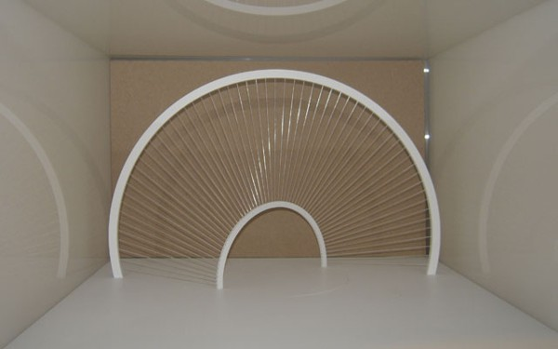
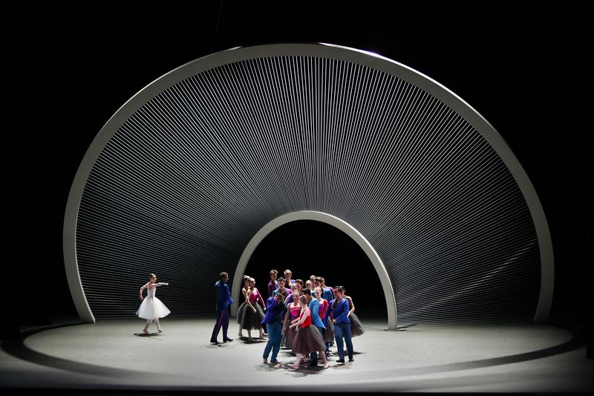

Slide 51
Calatrava as a ceramist and a sculptor……

Slide 52
The Torus
In the sculpture Torus of 1985, two cubes asymmetrically lean on the heads of many cones, being hold in position by ropes.
They are volumes suspended in the space forming a composition statically controlled but at the same time far away from any abstract rationality.

Slide 53
Calatrava’s exhibit at Palazzo Strozzi, Florence

Slide 54
The research of the motion
Many works of Calatrava suggest the possibility of the motion, and some are really moving.
For Santiago Calatrava motion, even only imagined or virtual, is a fruitful inspiration.

Slide 55
Entrance to the Monastery district of St. Galle
The entrance emerges and flattens to the ground, opening and closing like a sunflower

Slide 56
Calatrava’s wave at Meadows Museum, Dallas

Slide 57
Project of a movable canopy for Venice

Slide 58
Movable roof of the Milwakee Art Museum

Slide 59
The end

