Slide 1
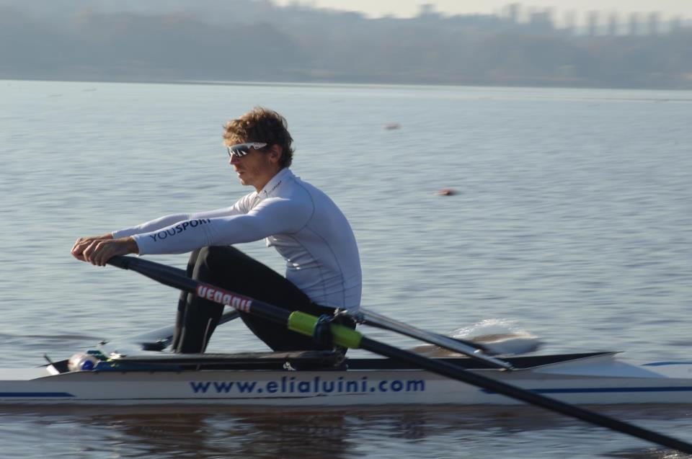
ELIA LUINI
Varese,
June 23,1979

Slide 2
GAVIRATE ROWING CLUB
- 1993, first National medal

Slide 3
NINO BIXIO ROWING CLUB
1997, Italian Championship

Slide 4
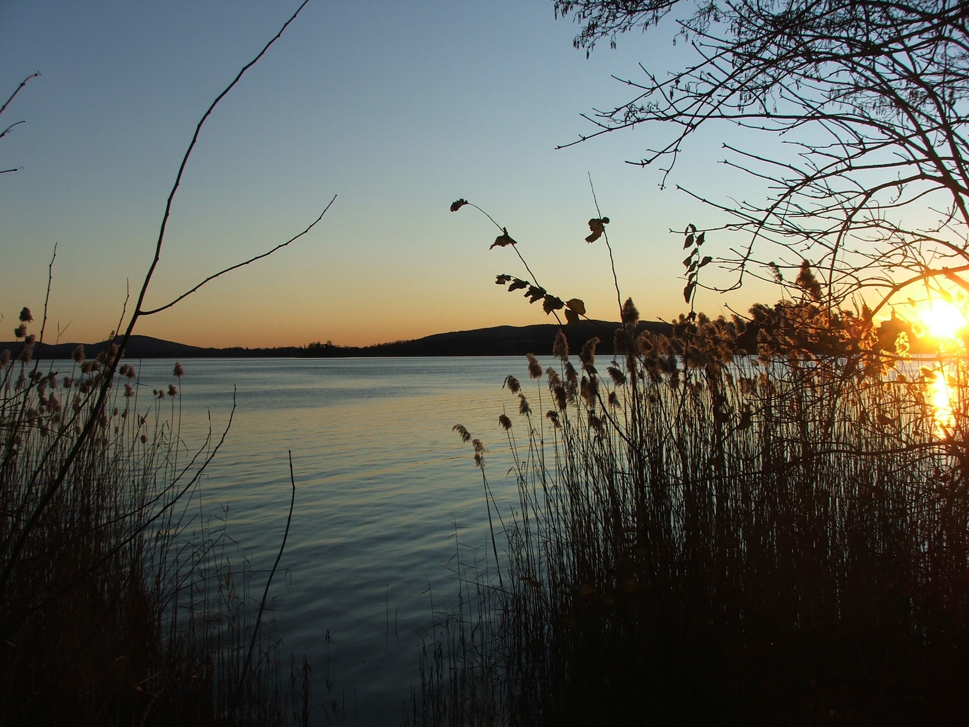
LUINI’S CAREER IN SINGLE:
9 Italian titles (from 1997 to 2007);
Greece, 1998 silver medal at the Nation Cup;
- 1998, bronze medal in the World Championship.

Slide 5
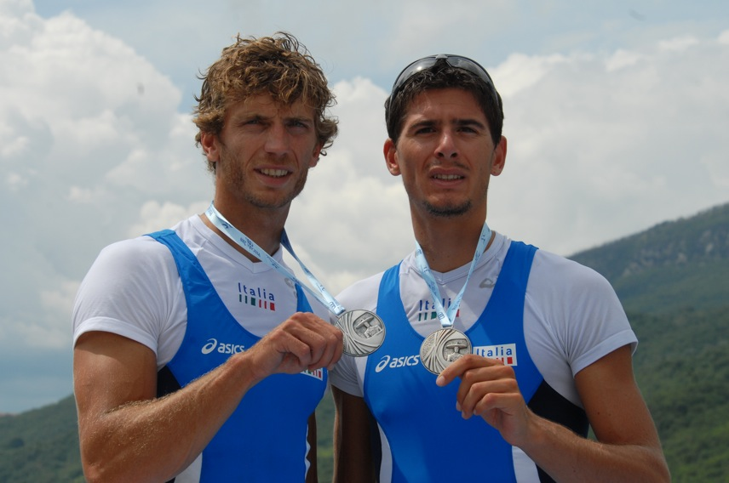
LUINI & PETTINARI : the GOLDEN DOUBLE
Olympic Games 2000, silver medal;
2001, World Championship in Lucerna and Mediterranean Games in Tunisi;
2002, World Championship in Siviglia.

Slide 6
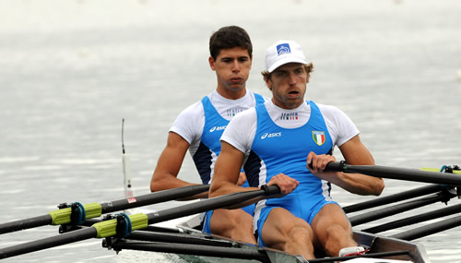
LUINI & MIANI
2006, silver medal at the World Championship in Eton:
2008, fourth at Olympic Games;
- 2009, silver medal at the Mediterranean Games in Pescara and at the European Championship in Brest.

Slide 7
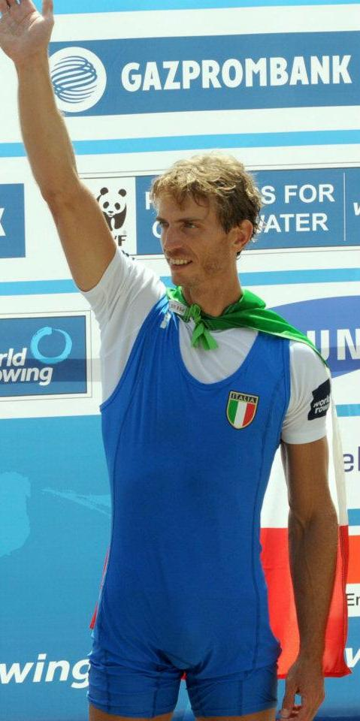
In 2000, Italian Republic President named him Officer of the Order of Merit of the Italian Republic.
Since 2004 he produced calendars for charity.

Slide 8
And now…
The newest Luini’s Film…
NEVER SEEN BEFORE!

