Slide 1
Symmetry in Platonic Solids

Slide 2
Polyhedra
A polyhedron is a solid figure bounded by flat faces and straight edges, i.e., by polygons.
Face﻿
A face of a polyhedron is any of the plane surfaces forming a polyhedron. The faces of a polyhedron are polygons.
Edge
An edge of a polyhedron is any of the line segments making up the framework of a polyhedron. The edges are where the faces intersect each other.
Vertex (pl. vertices)
A vertex of a polyhedron is any of the corner points of a polyhedron, i.e., a point where three or more polygonal faces meet.
Dihedral angle
A dihedral angle is the space between two intersecting planes. Every polyhedron has a dihedral angle at every edge.
Polyhedral angle
A polyhedral angle is the space enclosed by three or more planes that intersect in a vertex. Every polyhedron has a polyhedral angle at every vertex.

Slide 3
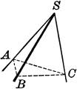
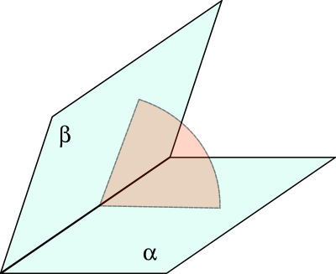
Activity 2
In pairs, Ss match words to pictures:
T hands out the pictures, Ss write words next to appropriate pictures.
T asks “what is number 1” to individual Ss and check the answer, and so on.
Reading of the definitions previously defined:
UK Ss read the words explaining where the stress goes.
3

Slide 4
Regular Polyhedra
A regular polyhedron is a polyhedron whose faces are congruent regular polygons which are assembled in the same way around each vertex.
This means that a regular polyhedron has all congruent dihedral angles and all congruent polyhedral angles.
The regular polyhedra that can be built are only five.
They are also known as Platonic Solids.

Slide 5
Regular Polyhedra Are Only 5
Let’s consider the following conditions:
At least three faces of a regular polyhedron must meet at any given vertex.
Those faces cannot lie on the same plane, therefore the sum of the angles converging on the same vertex must be lower than 360°.
The amplitude of the angles of a regular polygon increases with the number of its sides; we know that the amplitude of each internal angle of a regular polygon with n sides is

Slide 6
Activity 3
Trying constructions:
T divides Ss into 4 groups (8-9 Ss each).
T hands out paperboard polygons, each team receives a single shape (5 triangles, 4 squares, 4 pentagons, 3 hexagons).
Ss try to assemble polygons around a vertex to form a polyhedral angle.
Describing polyhedra:
A volunteer for each team describes the polyhedral angles they could build, showing practical results.
Another volunteer explains how they could assemble them or the reason they couldn’t.
6

Slide 7
Let’s analise all the possibile cases starting from the equilateral triangle
In an equilateral triangle each angle spans 60°
If three triangles meet at any vertex, the sum of the converging angles is
3·60° = 180° < 360°
We have a TETRAHEDRON,
4 faces, 4 vertices, 6 edges
7

Slide 8
Once more we use equilateral triangles
If 4 triangles meet at any vertex, we have
4·60° = 240° < 360°
OCTAHEDRON
8 faces, 6 vertices, 12 edges
8

Slide 9
If 5 triangles meet at each vertex, we have:
5·60° = 300° < 360°
ICOSAHEDRON,
20 faces, 12 vertices, 30 edges
It cannot exist any more polyhedra composed of triangles, as 6·60° = 360°
9

Slide 10
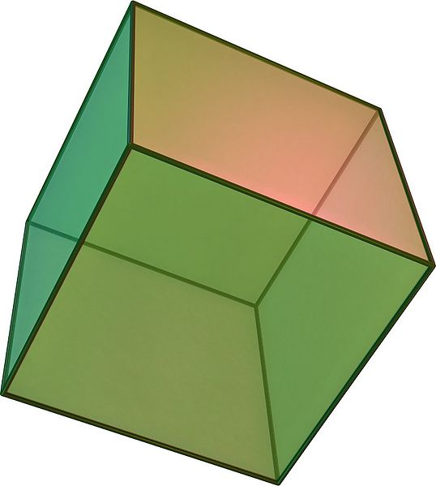
Now we use squares; each angle spans 90°
If three squares meet at any vertex, the converging angles sum to
3·90° = 270° < 360°
The CUBE , or hexahedron, has 6 faces, 8 vertices, 12 edges
It cannot exist any more polyhedra made up of squares, as 4·90° = 360°
10

Slide 11
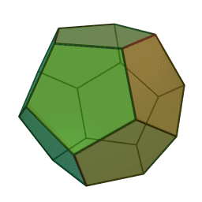
Let’s use pentagons; each angle spans 108°
If three pentagons converge on each vertex, the sum of the angles is
3·108° = 324° < 360°
the DODECAHEDRON has 12 faces, 20 vertices, 30 edges
No more polyhedra made up by pentagons can exist, as 4·108° = 432° > 360°
11

Slide 12
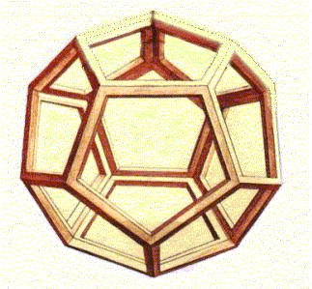
We can try to pass to examine hexagons, but…
It cannot exist any more polyhedra, as the angles of a hexagon are 120°, and 3·120° = 360°
Dodechaedron vacuum
(Leonardo da Vinci – De divina proportione)
12

Slide 13
D&D
The shapes of the dices of some popular role play follow the regular polyhedra
Dungeons & Dragons dices
13

Slide 14
Activity 4
1
2
3
4
5
6
7
8
9
10
11
Other name of cube
The regular polyhedron having four face
A polyhedron that has a polygonal base, whose vertices are joined to a single vertex
The regular polyhedron bounded by 20 triangles
A point where edges meet
The faces of a dodecahedron
Each face of a octahedron
The segment where two faces meet
The part of space between two half-planes
The regular polygon whose angles span 120°
The segments bounding a polygon
14

Slide 15
Euler’s Formula
Euler’s formula bounds the number of faces (f), vertices (v) and edges (e) of a regular polyhedron.
For any polyhedron we have
f + v = e + 2

Slide 16
Demonstration of Euler’s Formula
Let’s consider a regular solid whose faces are polygons with n sides and n vertices
If we start with a single face, it is obviously
f = 1 v = n e = n
We can immediately verify that
f + v – e = 1
16

Slide 17
We add now a second face f’ = f + 1
The number of edges should increase by n, but one edge is shared by the two figures:
e’ = e + n - 1
the number of vertices should increase by n, but two vertices are in common
v’ = v + n - 2
f’+v’-e’ = (f+1)+(v+n-2)-(e+n-1)
f’ + v’ - e’ = 1
17

Slide 18
Let’s add a third face f” = f’ + 1
The number of edges should increase by n, but two edges are in common
e” = e’ + n - 2
the number of vertices should increase by n, but three vertices are shared
v” = v’ + n - 3
f”+v”-e” = (f’+1)+(v’+n-3)-(e’+n-2)
f”+ v”– e” = 1
18

Slide 19
As we have seen, if we add other faces, it always remains
f + v – e = 1
But pay attention! The polyhedron is not yet closed!

Slide 20
Finally, we close the polyhedron with the last face
The number of faces increases again by 1.
But the numbers of edges and vertices don’t increase, as we can use the already existing ones.
Therefore
f + v – e = 2
20

Slide 21
Determination of the number of faces, edges and vertices
Let’s call n the number of sides or vertices of each polygonal face, and m the number of faces that meet at the same vertex of the polyhedron.
The total number v of vertices should be f·n, but we must consider that m polygons converge on the same vertex, so
v = f·n / m

Slide 22
The total number e of edges should be f·n, but we must consider that 2 polygons meet at the same edge, so
e = f·n / 2
By Euler’s formula,
f + f·n/m - f·n/2 = 2
Solving by f, we have

Slide 23
Faces, edges and vertices
So we have
f =
e =
v =
4m
2m-2n-nm
2mn
2m-2n-nm
4n
2m-2n-nm

Slide 24
Activity 5
Ss move to match cards
T hands out the cards with pictures and words to Ss;
Ss move to match the cards, forming group of 6;
each group read the characteristics of their polyhedron;
T asks Ss to feed back their answers;
UK Ss correct the answers.
24

Slide 25
Activity 6
Groups move to match polyhedra:
Previous groups must move to match polyhedra;
Number of faces of one group must match the number of vertex of another;
UK Ss describe the groups;
What are dual polyhedra?
25

Slide 26
Dual Polyhedra
Cube and octahedron are each other dual polyhedra.
The centre of the faces of a cube are the vertices of an octahedron and viceversa.
The tetrahedron is dual to itself.
26

Slide 27
Also the dodecahedron and the icosahedron are dual solids.
In this image, the edges of the dodecahedron are perpendicular to the faces of the icosahedron in their middle point, and viceversa.
We can also build the two polyhedra in such a way that the vertices of the dodecahedron coincide with the centres of the faces of the icosahedron or viceversa.
27

Slide 28
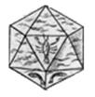
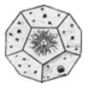
The Platonic Solids
Proclus was a historian of mathematics of the 5th century B.C. and a disciple of the neo-Platonic philosophy. He credited Pythagoras with the discovery of the five regular polyhedra.
The lack of sources that can be attributed to Pythagoras makes difficult to demonstrate this thesis, nevertheless in Plato’s Timeo , only a bit later than Pythagoras, we can find a precise description of the five regular bodies, i.e., the only possible polyhedra composed of regular polygons having equal faces, edges and solid angles. Plato will use this extraordinary discovery as a symbology of the universe and of its basic elements: fire (tetrahedron), earth (cube), air (octahedron) and water (icosahedron). The fifth regular polyhedron, the dodecahedron, was associated by Aristotle to the aithêr (ether) or quintessence that permeates the whole universe. This metaphore has some mathematical sense, given that the only regular polyhedron where it is possible to inscribe the remaining four is indeed the dodecahedron.
28

Slide 29
Melancolia I
A well known example of interest for the solids can be found in the work of the German Renaissance master Albrecht Dürer.
Among the elements appearing in his 1514 engraving Melancolia I , there is a solid that interested, and still interests, artists and scientists, even if it is not easy to understand the prospecttve the solid has been represented with.
The geometry and architecture instruments lie on the ground surrounding the musive figure of the Melanconia, unused. The scale pans are empty, none climbs the ladder, the sleeping greyhound is starving, the winged cherub is waiting to be dictated, while the passing time is shown by the hourglass.
The sphere and the truncated tetrahedron suggest the mathematical basis of architecture. The scene appears to be soffused with moon light. The moon rainbow, perhaps including a comet, can symbolise the hope in a better mood.
29

Slide 30
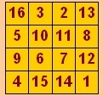
Magic Squares
On the right upper part of Dürer’s engraving one can see a magic square, which is considered one of the first examples of such an object in the Western world.
Activity 6a
Find out all symmetries in Dürer’s magic square!
30

Slide 31
Symmetries in Dürer’s Magic Square
There are also many groups of four cells which always sum to 34
The square is said to be symmetric as each cell and its symmetric one with respect to the centre always sum to 17.
16 | 3 | 2 | 13
5 | 10 | 11 | 8
9 | 6 | 7 | 12
4 | 15 | 14 | 1
16 | 3 | 2 | 13
5 | 10 | 11 | 8
9 | 6 | 7 | 12
4 | 15 | 14 | 1
16 | 3 | 2 | 13
5 | 10 | 11 | 8
9 | 6 | 7 | 12
4 | 15 | 14 | 1
The columns
The rows
The principal diagonals
The four corner cells
The 2x2 squares in the corners.
The 4 central cells
Finally, Dürer managed the square in such a way that the two central cells of the bottom row show the year of the engraving (1514).
31

Slide 32
Symmetry Groups
Here by a symmetry of a figure we mean any rigid transformation which takes the figure into itself, i.e., an Euclidean isometry.
In mathematics, the concept of symmetry is studied with the notion of a mathematical group. Every polyhedron has an associated symmetry group, which is the set of all transformations which leave the polyhedron invariant.
Possible symmetries are rotations, reflections, translation, and their compositions. Translations are meaningless for regular polyhedra, as they have a centre (of the inscribed or circumscribed sphere) that must remain fixed.
The order of the symmetry group is the number of symmetries of the polyhedron. One often distinguishes between the full symmetry group, which includes rotations and reflections, and the proper (or chiral) symmetry group, which includes only rotations.
32

Slide 33
The symmetry groups of the Platonic solids are known as polyhedral groups.
There are only three symmetry groups associated with the Platonic solids rather than five, since the symmetry group of any polyhedron coincides with that of its dual.
The three polyhedral groups are:
the tetrahedral group T;
the octahedral group O (which is also the symmetry group of the cube);
the icosahedral group I (which is also the symmetry group of the dodecahedron).
All Platonic solids except the tetrahedron are centrally symmetric, meaning they are preserved under reflection through the origin.

Slide 34
Activity 7
Mutual dictation
Symmetry groups
34

Slide 35
The Octahedral Group
The cube and the octahedron belong to this group. Let’s consider the rotations of a cube.
Any rotation will occur around an axis passing through the centre of the solid; this line will intersect the cube in two points, A and B.
To leave the cube unchanged, the points A and B can only lie on the following positions:
35

Slide 36
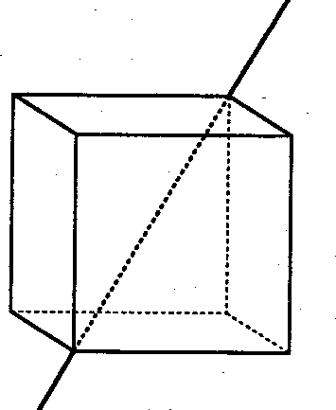
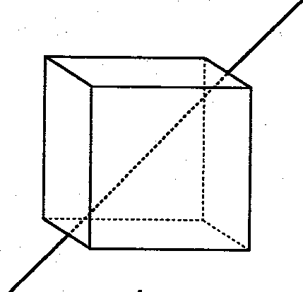
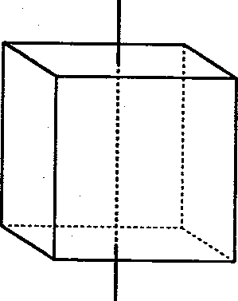
Opposed vertices
Middle points of two opposed edges
Centres of two opposed faces
36

Slide 37
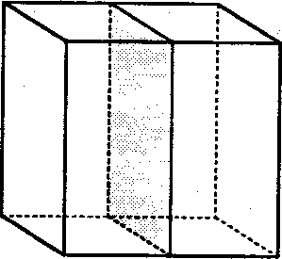
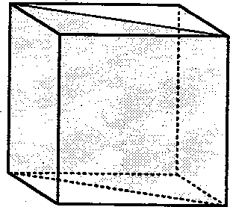
To detect the reflections, one must find the symmetry planes of the cube
Planes parallel to two opposed faces
Planes containing two opposed edges
37

Slide 38
Activity 8
Count the symmetries:
- Ss form 5 groups;
- Ss must find out the numbers of rotations and reflections of the octahedral group.
- A volunteer for each group reads the types and number of symmetries;
- T check out the answers.
38

Slide 39
Opposed vertices
There are only 4 lines of such a kind.
For each line there are two rotations, other than identity, that leave the cube invariant: one of 120° and one of 240°.
In total, 8 rotations.
Middle points of two opposed edges
There are 6 lines of this type.
Rotating around each of them of 180°, the cube maps onto itself.
In total, 6 rotations.
Centres of two opposed faces
These lines are 3
For any of them, the cube is left unchanged rotating of 90°, 180°, 270°.
In total, 9 rotations.
So we have 24 rotations, including identity
39

Slide 40
To detect the reflections, one must find the symmetry planes of the cube, that are nine in total:
Three planes parallel to two opposed faces
Six planes containing two opposed edges
We have 9 reflections in total
40

Slide 41
Rotational Reflections
We must also account for any possible composition of a reflection with a non-identical rotation that leaves the cube unchanged, excluding the equivalent cases.
The first of such symmetries is called antipodal application, and it is the symmetry with respect to the centre. This symmetry maps any vertex onto its opposed one, and is obtained by composing a reflection of any symmetry plane trough the centre with a rotation of 180°, whose axis is orthogonal to the selected plane.
Every other rotational reflection must be looked for starting from the already known group rotations, but leaving out all those of 180°, as their composition with a reflection will lead again to the antipodal application.

Slide 42
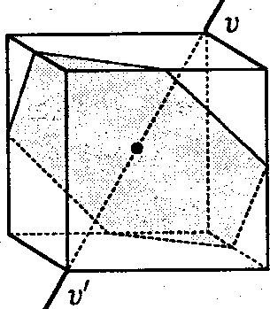
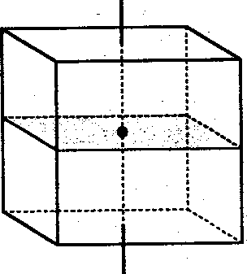
Axis joining two opposed vertices (v, v’):
the cube cuts the reflection plane with a regular hexagon whose vertices lie on the middle points of the six edges not adjacent to v, v‘;
the possible rotations are of 120° and 240°;
8 symmetries for this case.
Axis joining the middle points of two opposed edges:
The only possible rotation spans 180°, hence it is discarded.
Axis joining the centres of two opposed faces:
the reflection plane is parallel to the selected faces;
not accounting for the one of 180°, we have the rotations of 90° and 270°;
6 symmetries for this case.
Accounting for antipodal application, we have 15 rotational reflections

Slide 43
Orders of the Octahedral Group
Resuming:
24 rotations
9 reflections
15 rotational reflections
That makes 48 possible symmetries, that is the order of the full octahedral group O_{h}.
Not accounting for reflections, we have the order of the proper octahedral group O, that is 24.

Slide 44
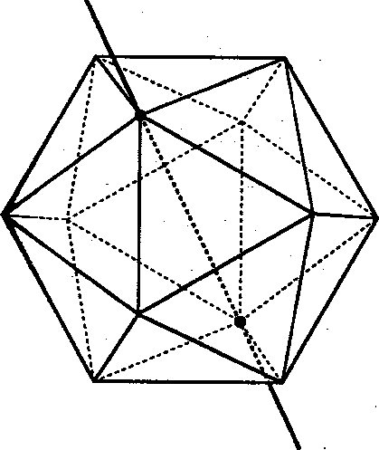
The Icosahedral Group
Let’s consider all the possible rotations:
Axis joining two opposed vertices
With respect to these lines, the rotations taking the icosahedron into itself are the multiples of 360°/5, namely, 72°, 144°, 216° and 288°.
These axis are six, hence we have 24 rotations.

Slide 45
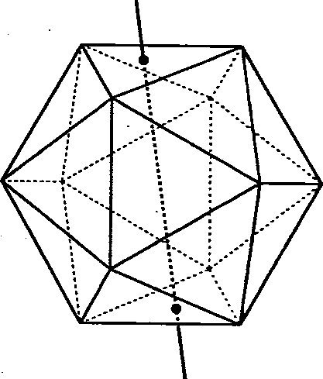
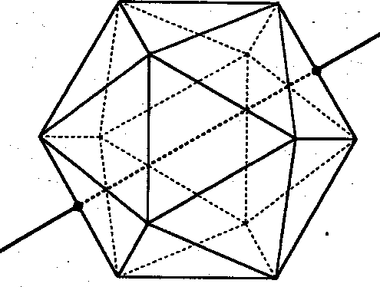
Axis joining the middle points of two opposed edges
For any of these 15 lines, there is only one rotation other than the identity mapping the solid onto itself, that is a rotation of 180°.
Therefore we have 15 rotations.
Axis joining the centres of two opposed faces
These lines are 10
For any of them, only the rotations of 120° and 240° take the solid into itself.
This leads to 20 rotations.
So we have 60 rotations, including identity
45

Slide 46
Orders of the Icosahedral Group
One can demonstrate that reflections and rotational reflections that map the icosahedron onto itself are 60.
The order of the full icosahedral group I_{h} (as well as dodecahedral) is therefore 120.
Not accounting for reflections, we have that the order of the proper icosahedral group I is 60.

Slide 47
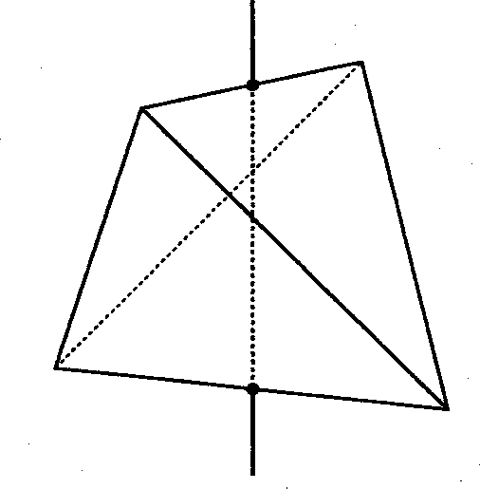
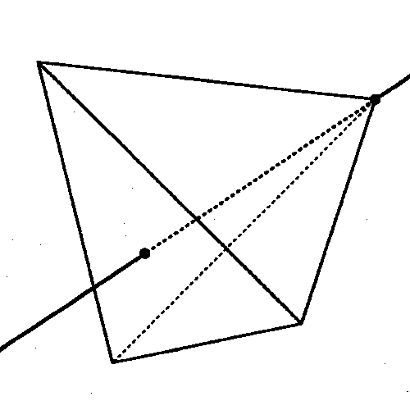
The Tetrahedral Group
Now the situation is different, as there are neither vertices nor opposed faces; therefore, T does not contain the antipodal application.
Let’s consider the rotations:
Axis joining the middle points of two opposed edges:
The solid returns to itself for a rotation of 180°.
There are 3 of such lines, so 3 rotations.
Axis joining the centre of a face to the opposed vertex:
The tetrahedron returns to itself for rotations of 120° and 240*.
There are 4 of such lines, so 8 rotations.
47

Slide 48
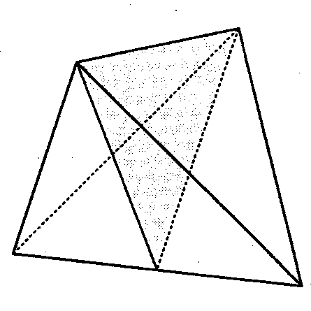
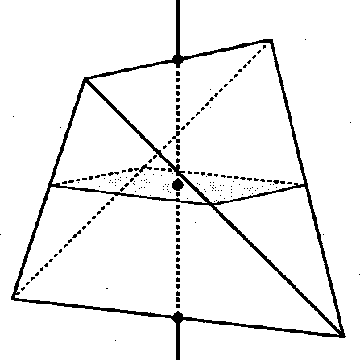
Reflections
Rotational reflections
Any symmetry plane is detected by an edge and the middle point of the opposed edge.
These planes are six.
Any rotation axis joins the middle points of two opposite edges. The reflection plane is orthogonal to that line through the centre of the tetrahedron.
There are three axis and the rotation can be of 90° or 270°.
We have 6 rotational reflexions.
48

Slide 49
Orders of the Tetrahedral Group
The order of the full tetrahedral group T_{d} is therefore 24.
Not accounting for reflections, we have that the order of the proper tetrahedral group T is 12.

Slide 50
Symmetry Properties of Platonic Solids
It is of interest to note that the orders of the proper are precisely twice the number of edges in the respective polyhedra (12, 24 and 60, respectively).
The orders of the full symmetry groups are twice as much again (24, 48 and 120).
The symmetry groups listed in the next table are the full groups with the rotational subgroups given in parenthesis (likewise for the number of symmetries).
The Schläfli symbol shows the couple { p, q } where p is the number of edges for each face, and q the number of faces meeting at the same vertex.

Slide 51
Symmetry Properties of Platonic Solids
Polyhedron |  | Schläfli symbol | Dual polyhedron | Symmetries | Symmetry group
tetrahedron |  | {3, 3} | tetrahedron | 24 (12) | T_{d} (T)
cube |  | {4, 3} | octahedron | 48 (24) | O_{h} (O)
octahedron |  | {3, 4} | cube
dodecahedron |  | {5, 3} | icosahedron | 120 (60) | I_{h} (I)
icosahedron |  | {3, 5} | dodecahedron

Slide 52
Activity 9
Running treasure hunt
T divides Ss into 8 teams (4-5 Ss each).
T prepares the labels of the puzzle and stick them around the room.
Each team will send a member, one at a time, to look at the puzzle, and try to memorise it.
This student will then return to his/her team and repeat the clue so that everyone can write it down.
Now the team try to find out the answer, and select the right key.
When this has been done, the second team member will look at the second clue, and so on.
At the end, all keys are put together to discover the secret word.
The first team to discover the answer wins 20 points, the second 18 points, and so on.
Each team will give the T a copy of the whole puzzle: a point is lost for every miswritten word.
Speak at a whisper pitch, not to be heard by other teams!
52

