Slide 1
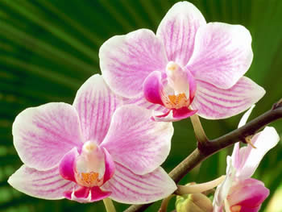
Symmetry
and
asymmetry
in the angiosperms

Slide 2
Angiosperm :
from Greek αγγειον + σπερμα (protected seed)
Characteristics
vascular plants
having seeds producing flowers and fruits

Slide 3
How many species exist??
720
250 000 !!
20 000

Slide 4
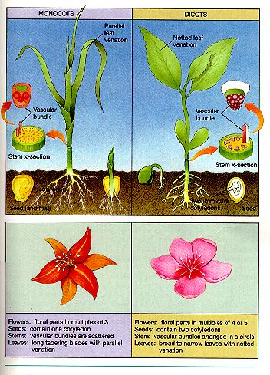
MONOCOTS
mostly herbaceous
Angiosperms
DICOTS
herbaceous
arboreal

Slide 5
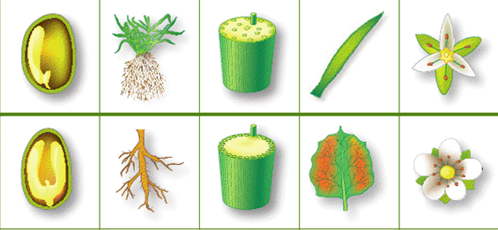
Number of shape of the disposition of ribs of the structure of
cots roots conductive vessels leaves the flowers
monocots
dicots

Slide 6
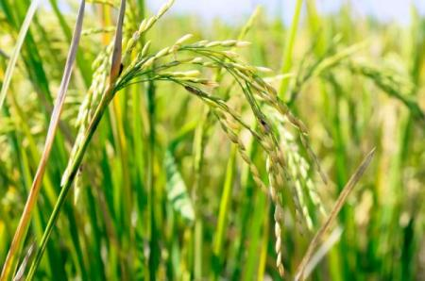
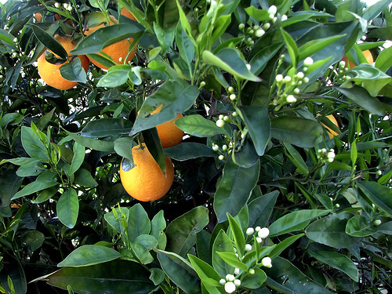
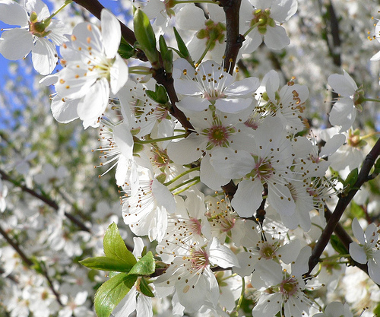
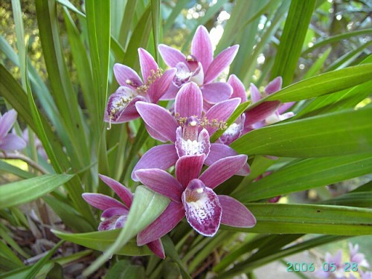
Monocots or Dicots ??
M
D
M
D
M

Slide 7
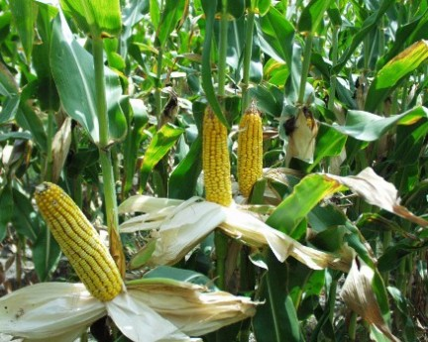
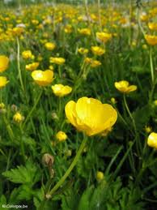
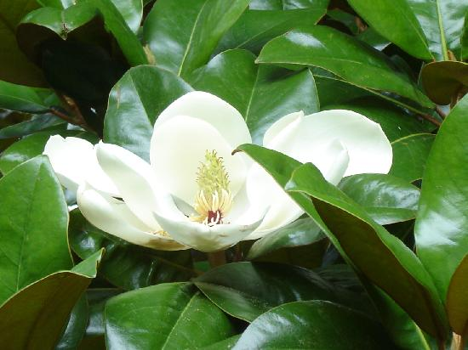
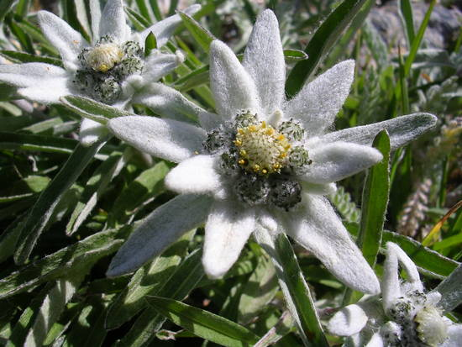
M
D
M
D
D

Slide 8
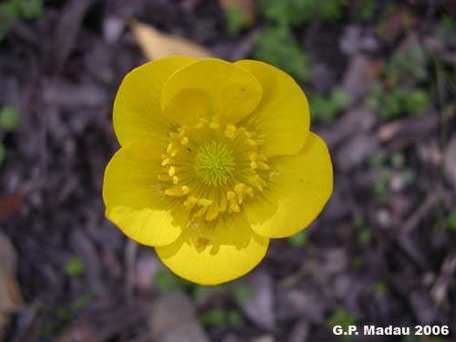
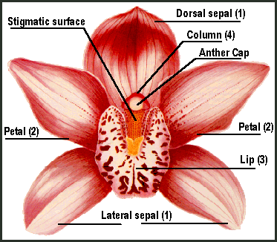
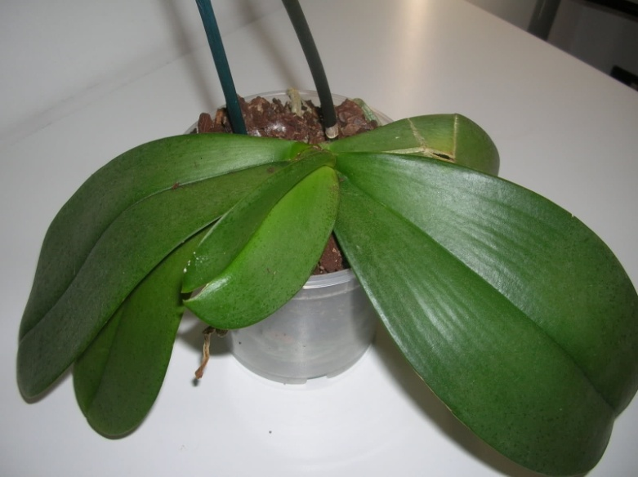
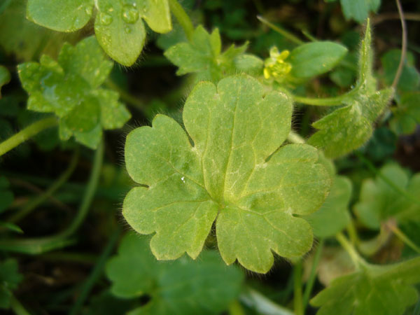
Macroscopic
zygomorphic = bilateral
Monocots
Dicots

Slide 9
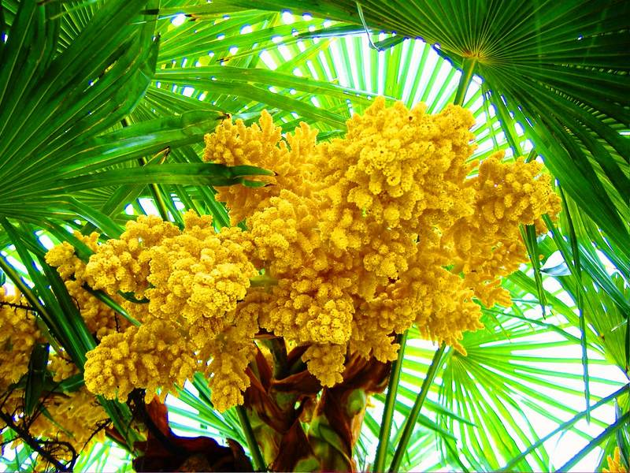
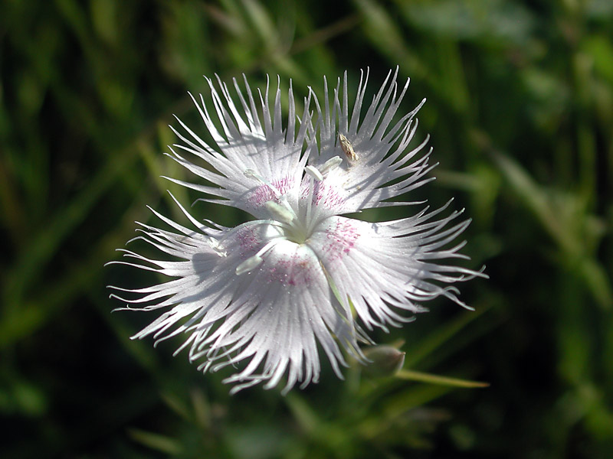
Actinomorphic = radial
Monocots
Dicots

Slide 10
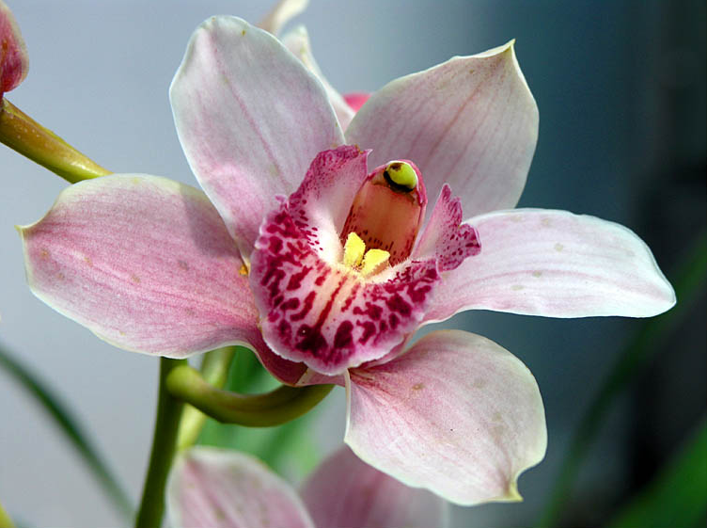
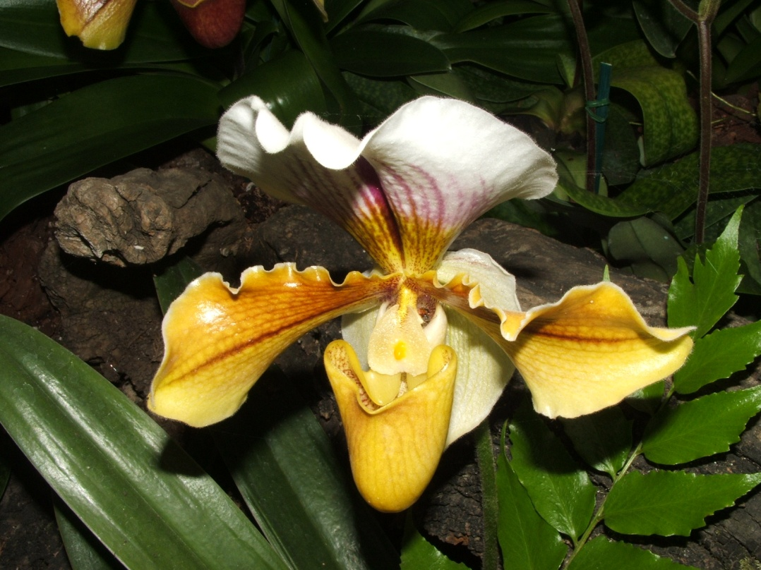
Monocots or Dicots?
M
Z
M
Zygomorphic or Actinomorphic?
Z

Slide 11
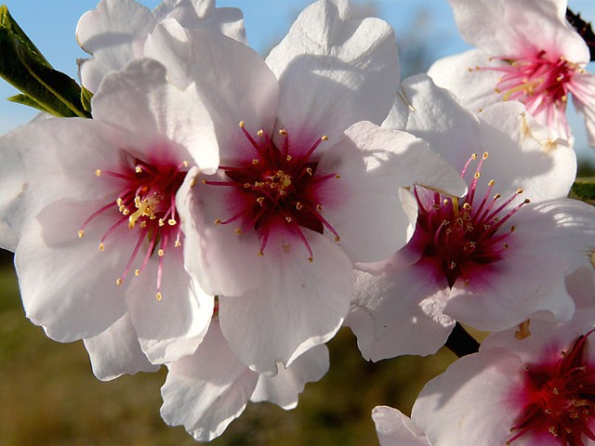
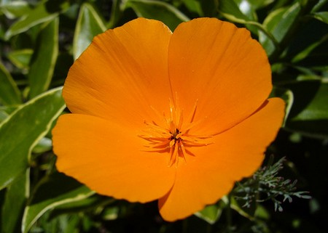
A
Monocots or Dicots?
D
D
Zygomorphic or Actinomorphic?
A

Slide 12
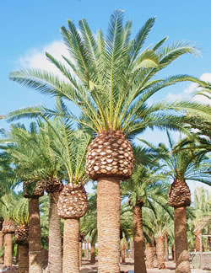
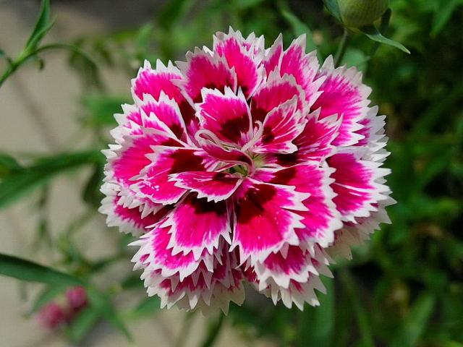
Monocots or Dicots?
A
M
A
D
Zygomorphic or Actinomorphic?

Slide 13
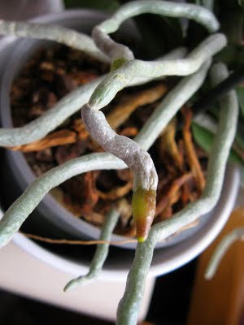
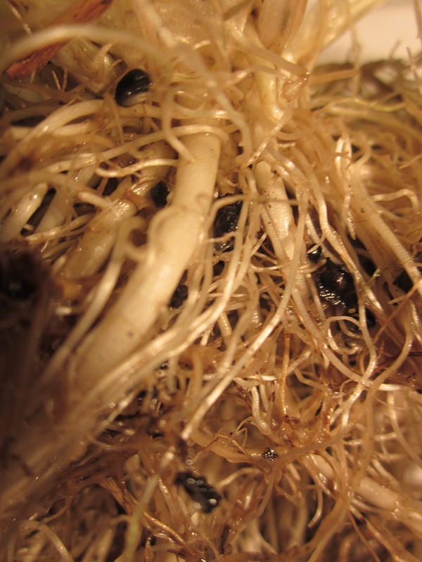
SYMMETRICAL ??
Monocots
Dicots

Slide 14
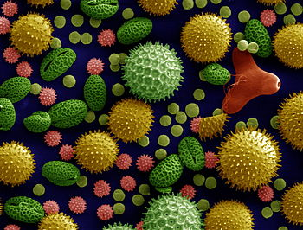
Pollens
Microscopic
Helianthus annuus
Sunflower
Oenothera fruticosa
Evening primrose
Sidalcea
Malviflora
Mallow
Lilium auratum
Lily
Ipomoea purpurea
Purple morning glory
Ricinus communis
Castor bean plant

Slide 15
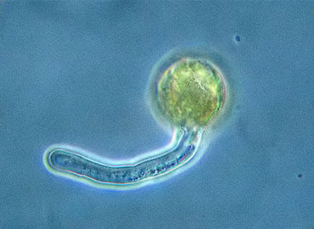
What is it ??
Pollen grain of figwort (Ranunculus ficaria)

Slide 16
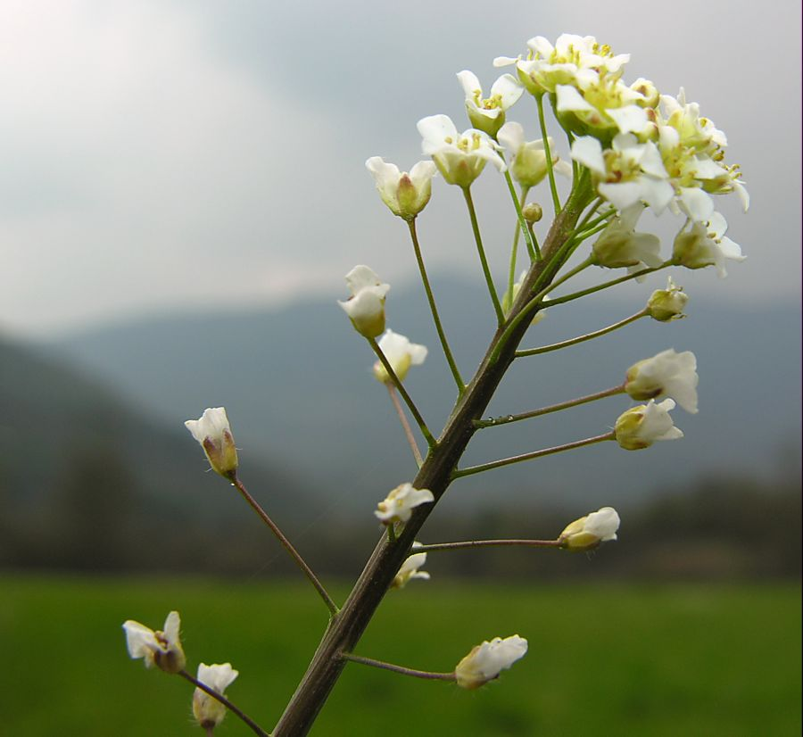
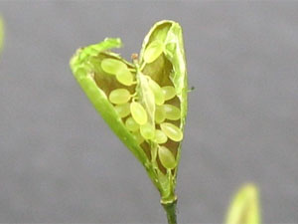
Ovary of Capsella

Slide 17
Conclusion
When the flower is star-shaped it is actinomorph, i.e., it has a radial symmetry
On the contrary, when the flower is butterfly-shaped it is zigomorph, i.e., it has a bilateral symmetry

